Slide 1
Prediction of LC50 value using QSAR models

Slide 2
Objective:
The objective of the study is to develop Quantitative Structure-Activity Relationship (QSAR) models for predicting the lethal concentration at which 50% of a population (LC50 value) is affected by a chemical compound or substance. These models will leverage the structural and physicochemical properties of the chemical compounds to establish relationships with their corresponding LC50 values, ultimately allowing for accurate and reliable predictions of the toxicity of new and untested chemicals.

Slide 3
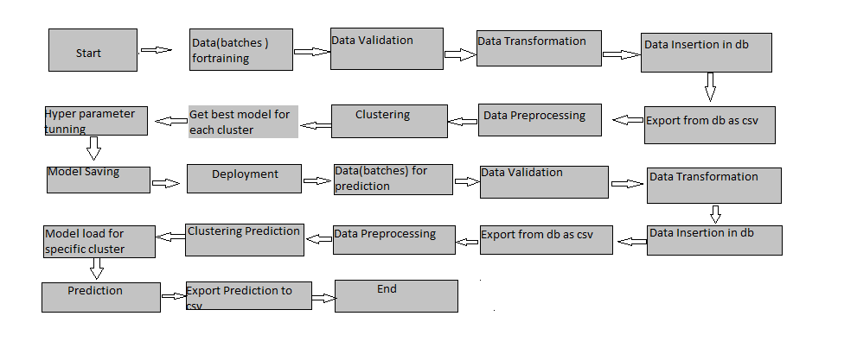
Architecture

Slide 4
Data Validation and Data Transformation :
Name Validation - Validation of files name as per the DSA. We have created a regex pattern for validation. After it checks for date format and time format if these requirements are satisfied.
Number of Columns
Name of Columns
Data type of columns
Null values in columns

Slide 5
Data Insertion in Database:
Table creation :-
Insertion of files in the table -

Slide 6
Model Training:
Data Export from Db :
The accumulated data from db is exported in csv format for model training
Data Preprocessing
Performing EDA to get insight of data like identifying distribution , outliers ,trend
among data etc.
Check for null values in the columns. If present impute the null values.
Encode the categorical values with numeric values.
Perform Standard Scalar to scale down the values.

Slide 7
Model Selection –
After the clusters are created, we find the best model for each model. By using
Different algorithms.

Slide 8
Prediction:
It takes number of independent variables value after that on the basis of the algorithm it predicts the dependent variable value that is LC50 value.

